Slide 1
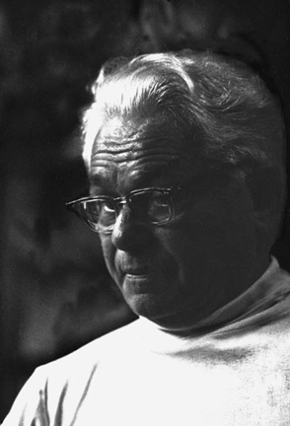
Pilates History
Pilates Philosophy:
“A few well-designed movements, properly performed in a balanced sequence, are worth hours of doing sloppy calisthenics or forced contortion”.

Slide 2
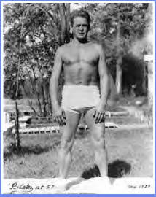
Joseph Pilates (Pi-LAH-teez) was from Germany & lived to be a robust & vital 87 year old icon.
“People won’t understand the brilliance of my work for 50 years”.

Slide 3
When do you think Pilates started?
What year or time period?

Slide 4
As a child Pilates suffered with …
Rickets
Rheumatic fever
Asthma

Slide 5
Movement Forms that Influenced Pilates:
Boxing
Circus Arts: He was a circus performer
Marital Arts
Gymnastics

Slide 6
CONTROLOGY written in the 1920’s
What word do you notice that hints towards Pilates’ philosophy?

Slide 7
“Contrology develops the body uniformly, corrects wrong postures, restores physical vitality, invigorates the mind, and elevates the spirit”.

Slide 8
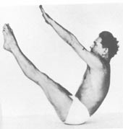
How did Pilates develop Contrology?
Pilates moved to England during the beginning of WWI
Incarcerated as an “enemy alien”
Pilates influenced detainees to follow his exercise regime – “Contrology”
So beneficial that they survived the 1918 influenza epidemic because of the Pilates Principle of Diaphragm Breathing.

Slide 9
What are the benefits of Pilates?

Slide 10
Benefits of the Pilates Method
Pilates helps to:
Who Can Do Pilates?
Increases balance between strength & flexibility
Improves coordination
Releases stress
Improves posture
Incorporates breathing techniques
Increases core abdominal strength
Recommended for all ages 12 and up
Used in injury prevention & rehabilitation work
Improves technique for athletes & dancers

Slide 11
How many exercises did Pilates design?

Slide 12
OVER 500 Exercises!!!!!!

Slide 13
The 6 Pilates Principles
Centering: Physically bringing the focus to the center of the body, the powerhouse area between the lower ribs and pubic bone.
Concentration: Bring full attention to the exercise : do it with full commitment, maximum value will be obtained from each movement.
Control: Every Pilates exercise is done with complete muscular control. No body part is left to its own devices.
Precision: There is an appropriate placement & alignment relative to other body parts, and trajectory for each part of the body.
Breath: Most Pilates exercises coordinate with the breath, and using the breath properly is an integral part of Pilates exercise.
Flow: Fluidity, grace, and ease are goals applied to all exercises. The energy of an exercise connects all body parts and flows through the body in an even way.

Slide 14
Pilates worked with WWI Veterans
Confined to hospital beds
Their Muscles were atrophying
Unable to participate in mat exercises
He developed a way to condition their bodies and cleverly designed apparatus to rehabilitate them right from their hospital beds and wheelchairs.
Pilates restored the soldiers back to health

Slide 15
Pilates Apparatus
Reformer

Slide 16
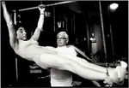
Cadillac
Influenced by the circus
Pull Ups on the Cadi

Slide 17
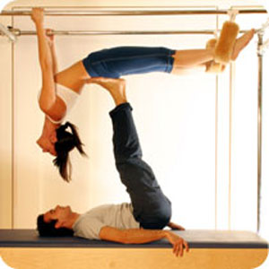
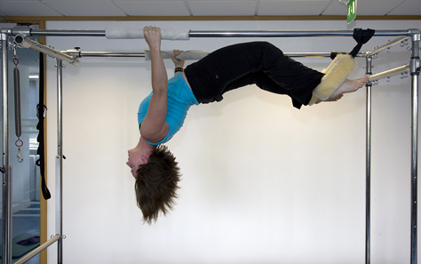

Slide 18
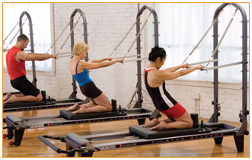
Half Trapeze – combo of reformer and Cadillac

Slide 19
Pilates Apparatus: Wunda Chair designed to fit in small areas

Slide 20
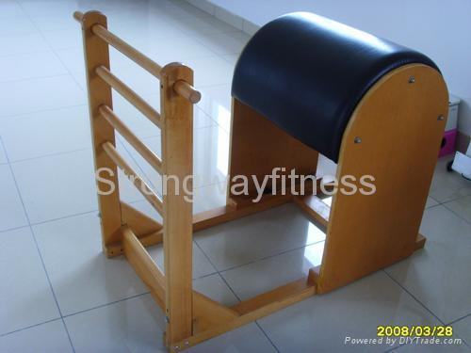
Laddar Barrell

Slide 21
Joseph Pilates moves to NYC after WWI
- Started a NYC studio
- Worked at Dance Festivals such as Jacob’s Pillow
- Worked with famous dancers and influenced and helped shape dance training

Slide 22
Q: Who is the Mother of Modern Dance?

Slide 23
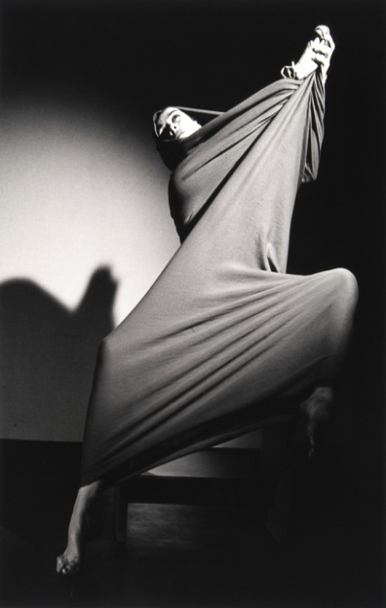
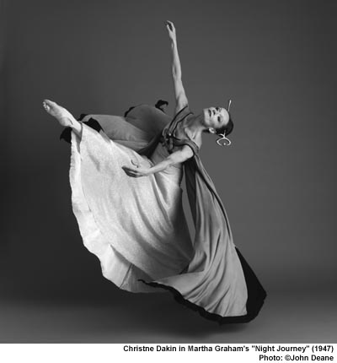
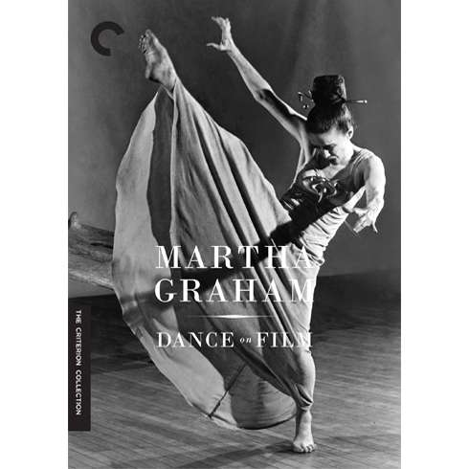
Martha Graham

Slide 24
Martha Graham

Slide 25
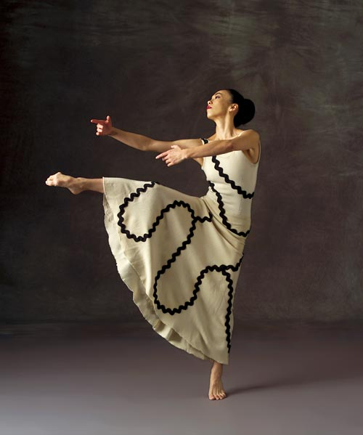
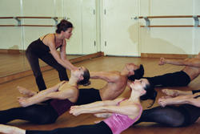
Graham class and contraction

Slide 26
Pilates’ Influence
Pilates Thigh Stretch
Martha Graham Hinge

Slide 27
Pilates Influenced Rudolf von Laban

Slide 28
Labanotation in action

Slide 29
Labanotation

Slide 31
Who is one of the most famous Ballet choreographers?

Slide 32
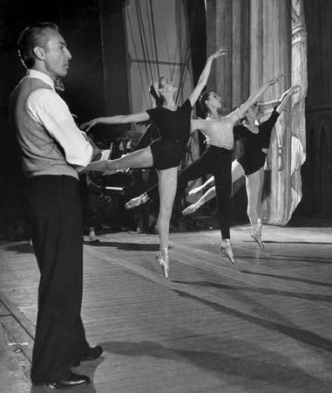
George Ballanchine

Slide 33
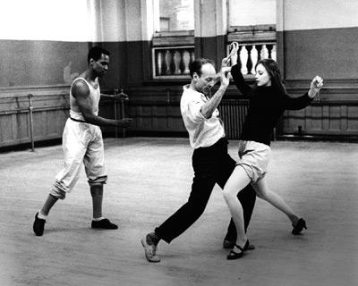

Slide 34
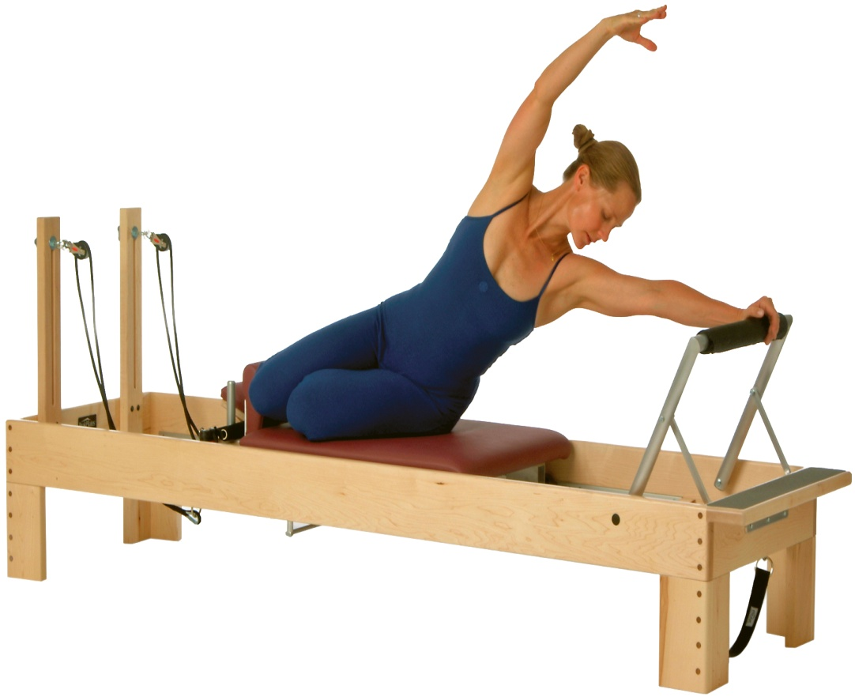
Balletic Movement in Pilates

Slide 35
Joseph Pilates on the Ped-O-Pull

Slide 36
Joseph Pilates working on the Reformer

Slide 37
Joseph Pilates working with a client in his NYC studio

Slide 38
Joseph Pilates creating exercises

Slide 39
Exercises on the Reformer
High Bridge
Arabesque

Slide 40
Reformer vs. Mat
Short Spine in the straps
Rollover

Slide 41
Downstretch
Upward Facing Dog

Slide 42
SNAKE
CLIMB A TREE

Slide 43
Joe working with someone on the Cadillac

Slide 44
Control Front

Slide 45
Pilates doing Squats on the Reformer

Slide 46
Pilates exercise called the STAR

Slide 47
